Slide 1

Hospital Occupancy Rates in Turkey During the Covid-19 Process
Prepared by Duygu Uçgun

Slide 2

During the Covid-19 process, bed occupancy rates in Turkey gradually increased. People could not find vacancies in hospitals. Private hospitals were not adequately equipped. Therefore, all the burden was in the hands of the State hospitals, that is, the State. Inspired by a scenario I witnessed, I decided to examine hospital occupancy rates.

Slide 3

Although the pandemic seemed to be under control in Turkey at first, it gradually turned into an increasingly difficult process due to psychological and social reasons. That's why I examined the beginning of the pandemic, namely April 2020, the times when the pandemic was felt the most in Turkey, in 3 different times: December 2020 and finally April 2021, which is a current time interval.

Slide 4
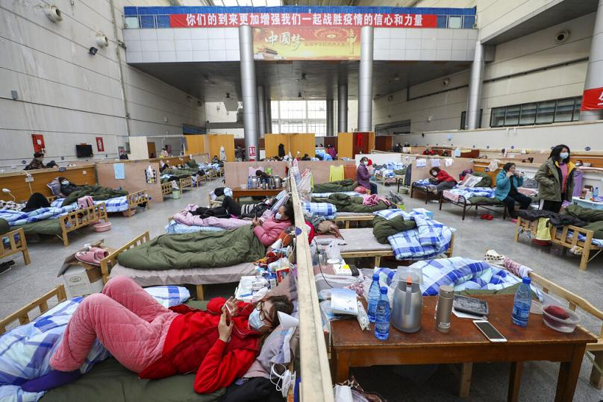
Non-compliance with the measures, insufficient measures, the psychological effects of health workers and the perspective of citizens on the pandemic process have been effective in the increase in hospital occupancy rates. However, Turkey has carried out the pandemic process to a large extent in comparison with other countries.

Slide 5
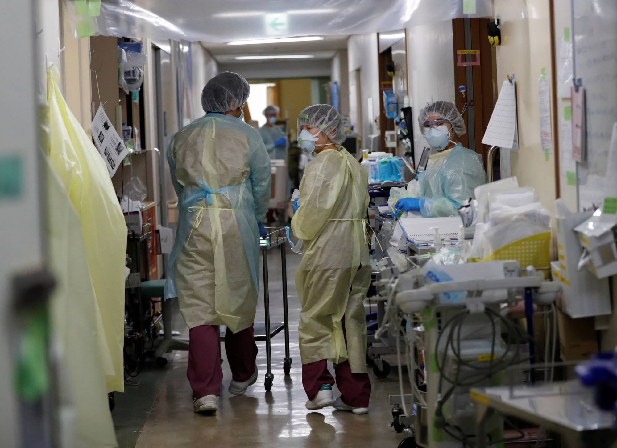
The psychological effects of hospital staff were one of the factors I encountered the most. It was a miracle that the tired doctors and nurses were able to work in the hospital. The perfect progress of this process could not have been expected anyway. But the health system has been seriously challenged during the pandemic period.

Slide 6
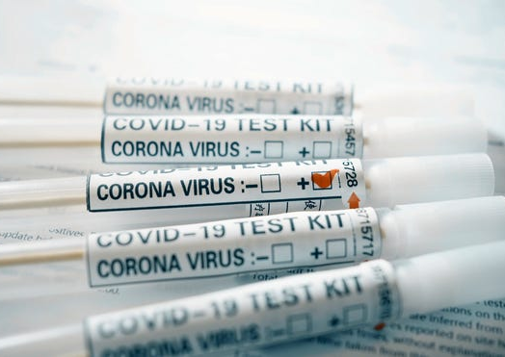
I visualized the data sets I created on the hospital occupancy rates in Turkey and made them ready for presentation. There were many issues that I encountered in this review. The only reason for this is that the pandemic process is still ongoing. The covid-19 pandemic, which is a global epidemic, has led to interpersonal problems, discussions and chaos. I was able to see this more clearly when trying to collect data in this project. Many sources do not believe the accuracy of the data published by the health ministry in Turkey. But I created these datasets using many sources.

Slide 7
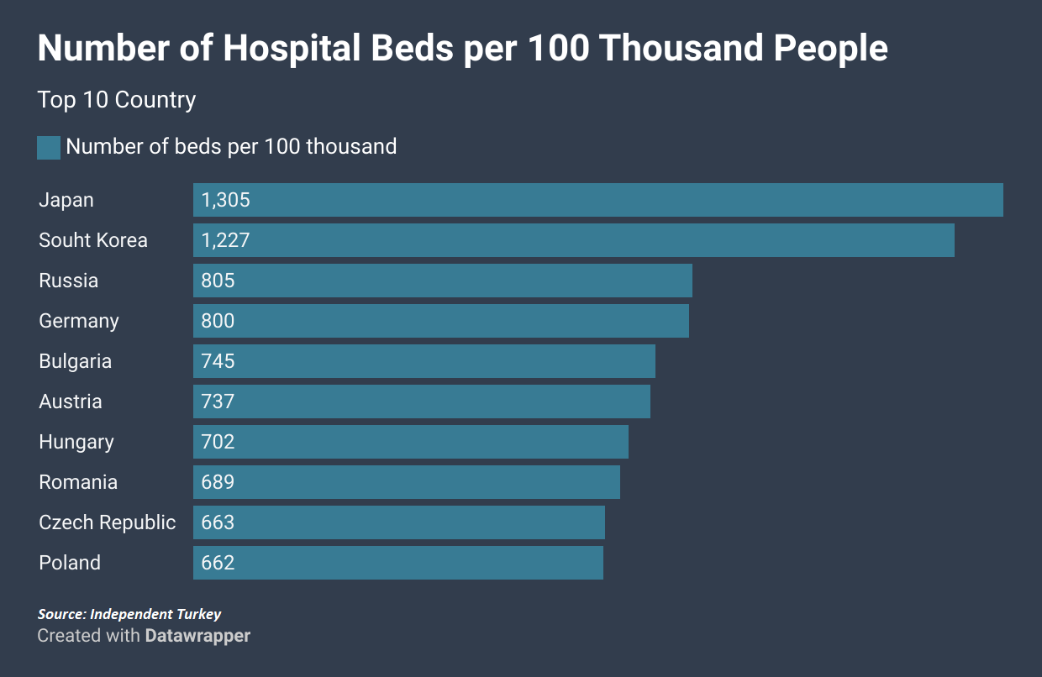
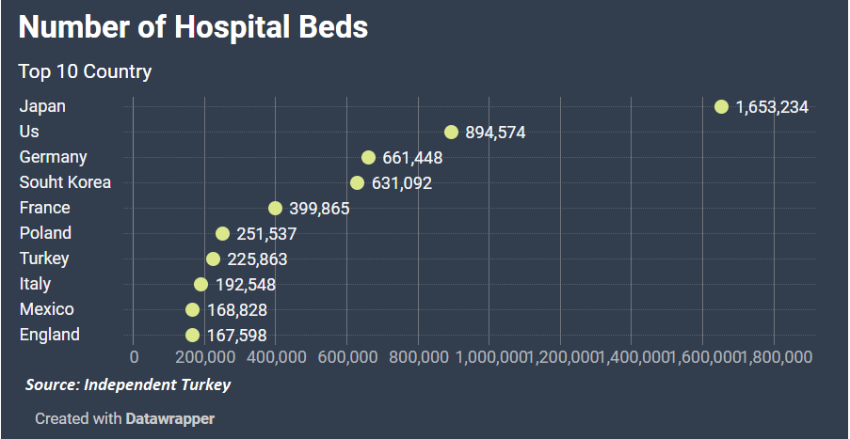

Slide 8
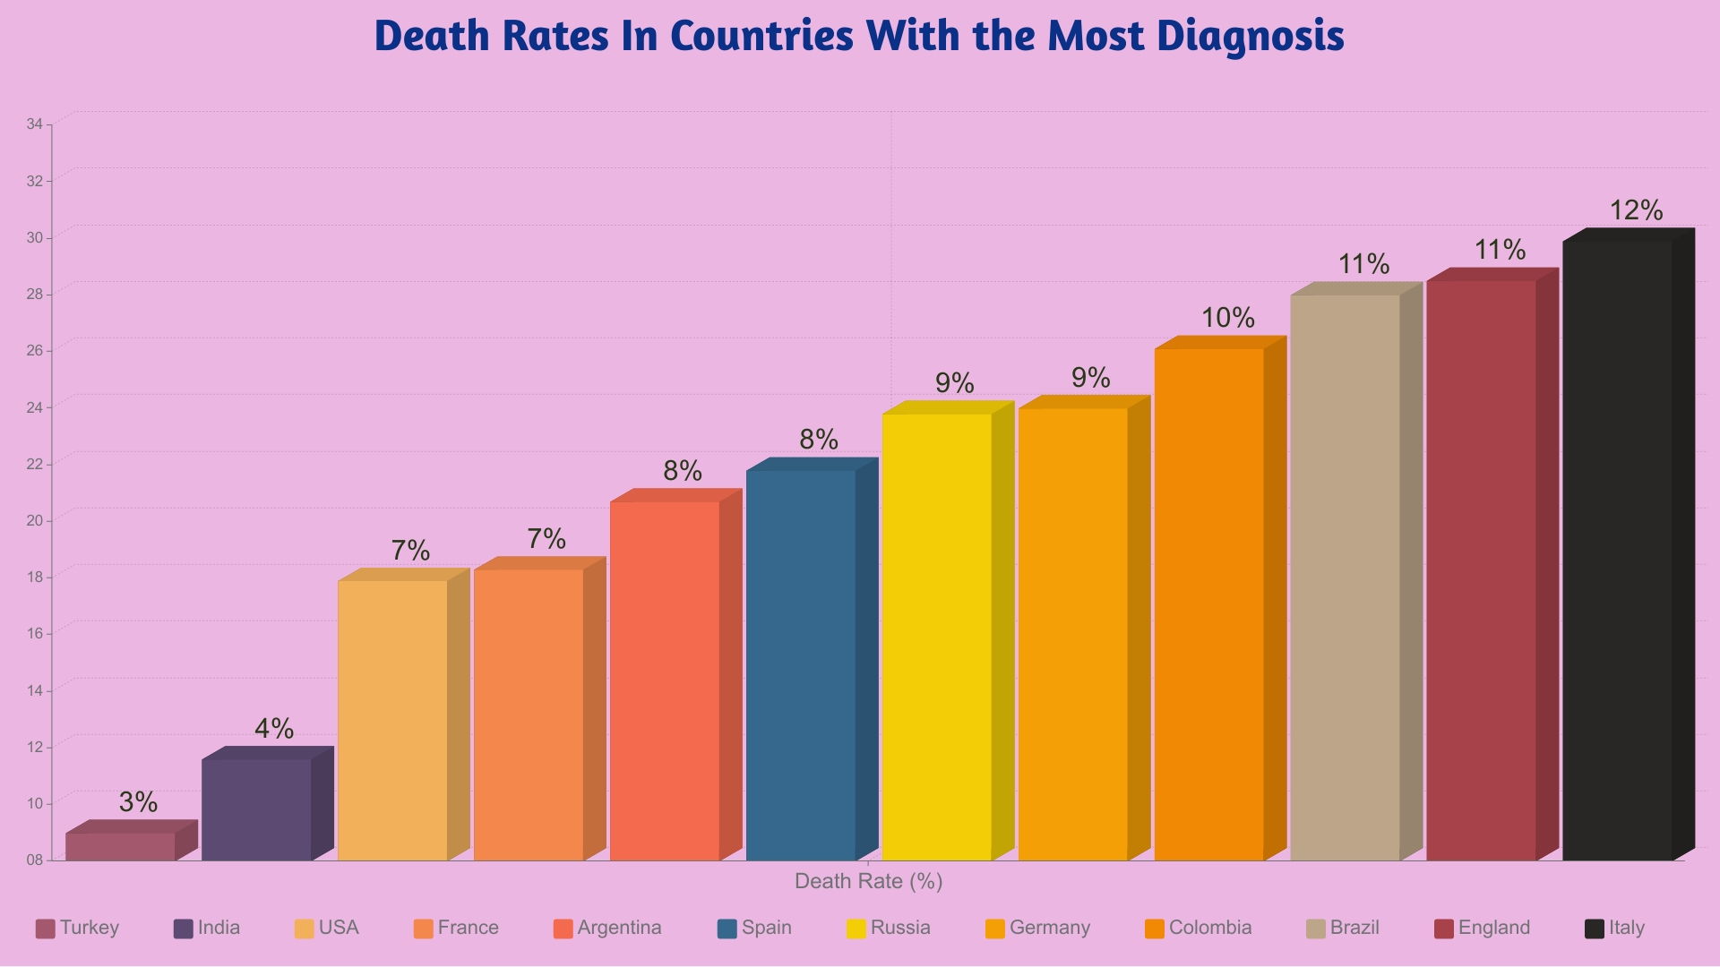

Slide 9
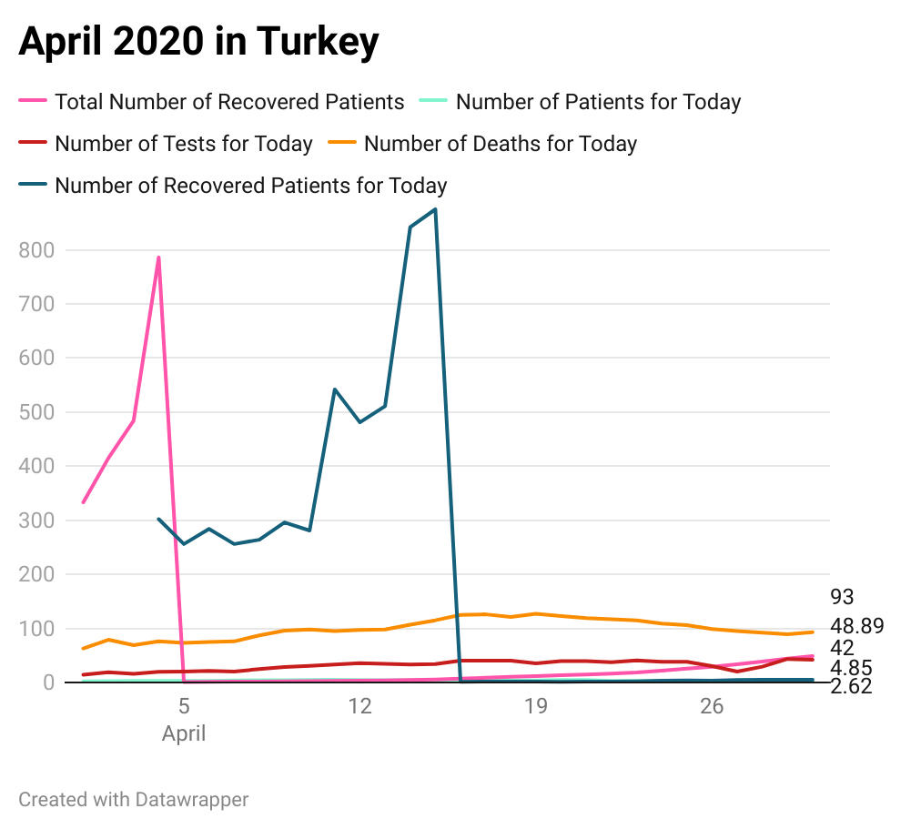

Slide 10
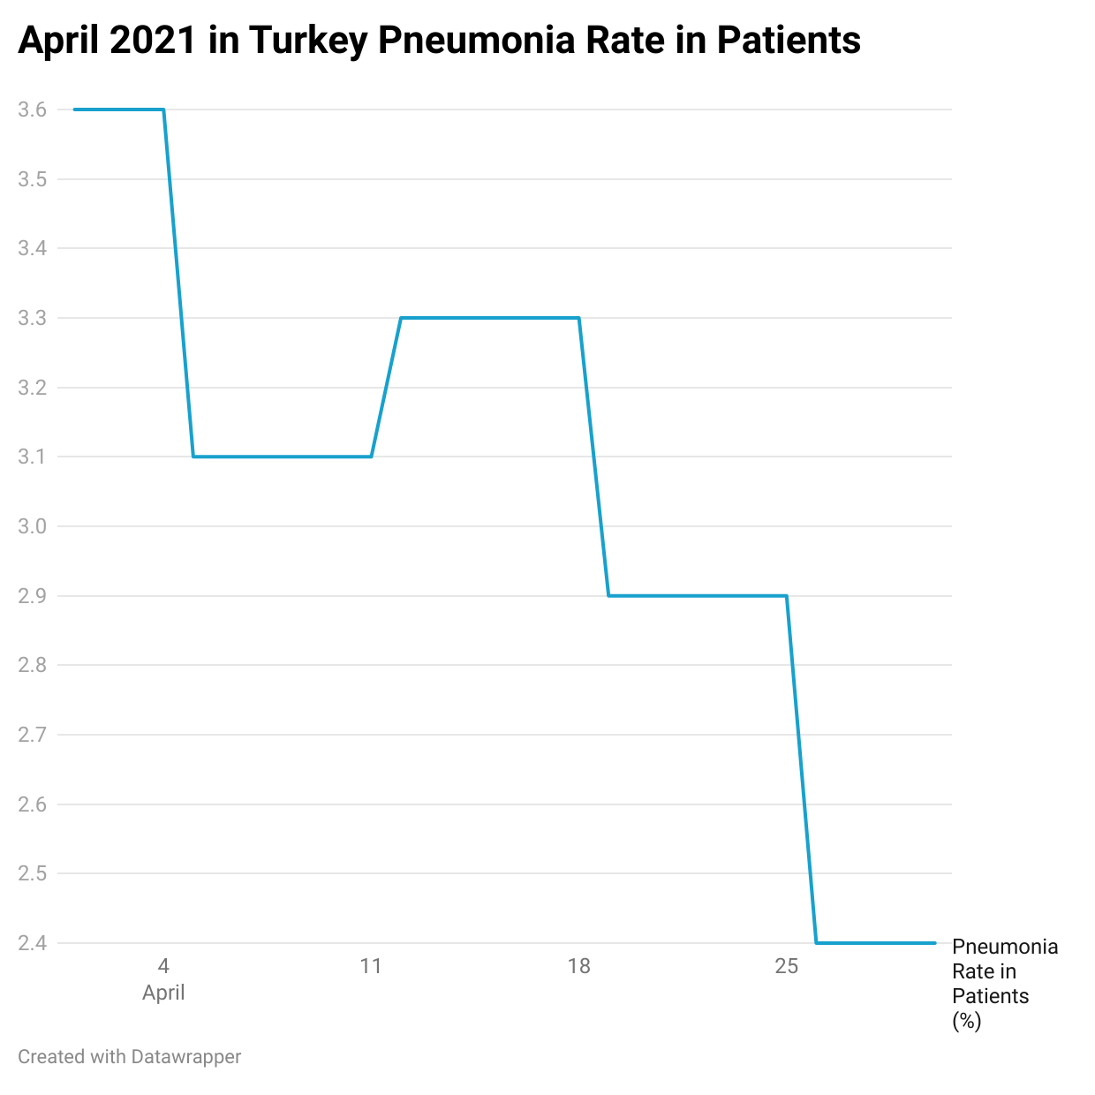
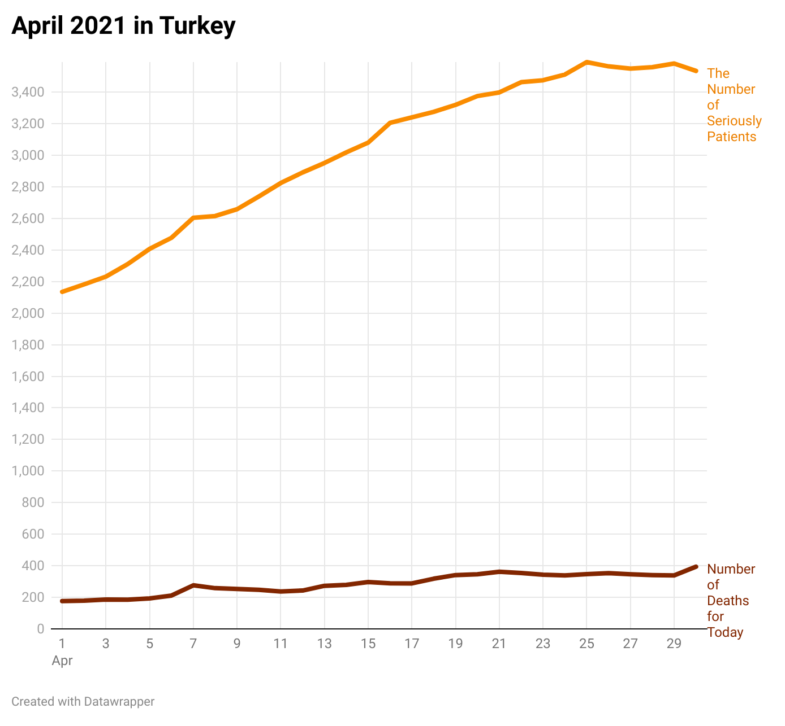

Slide 11
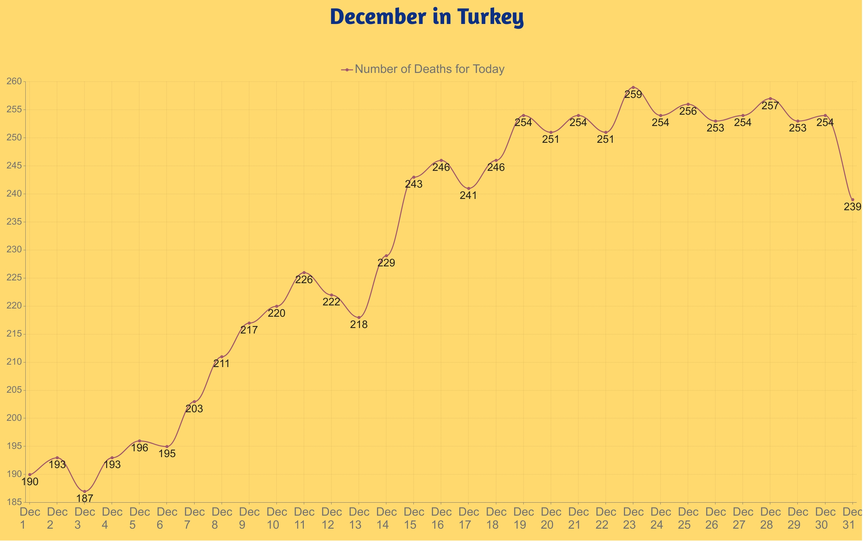

Slide 12
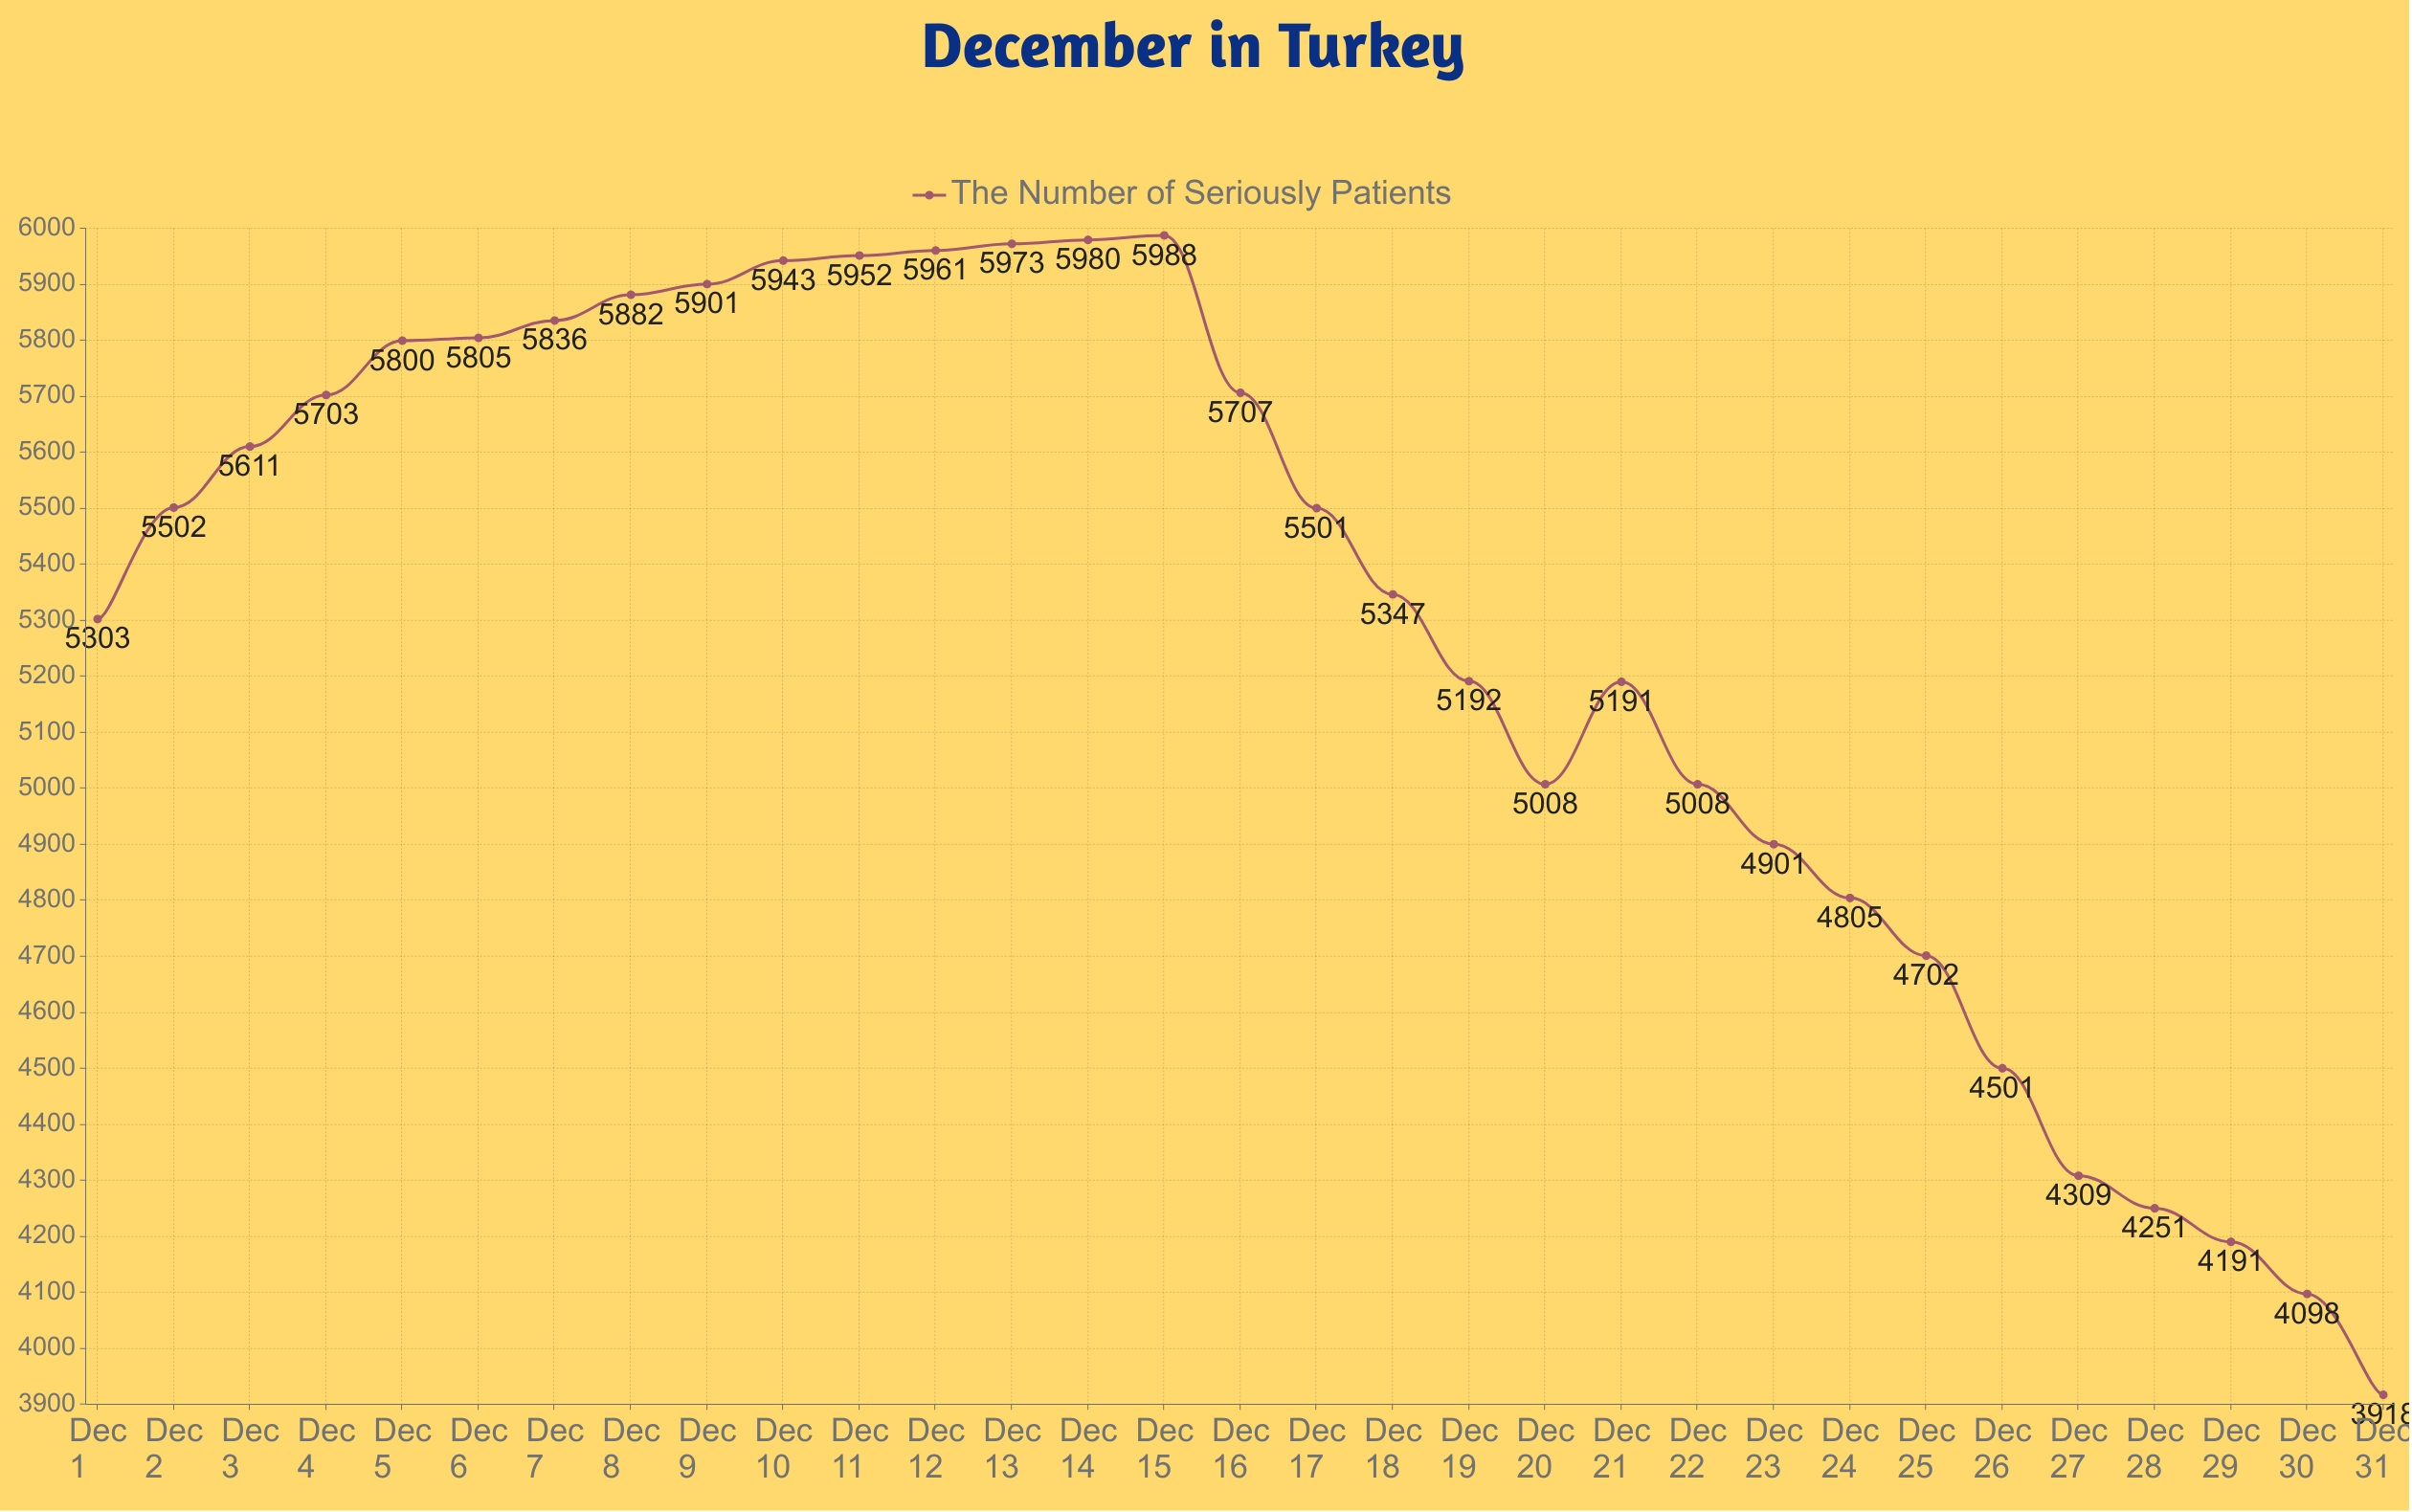

Slide 13
